Slide 1

DAVID LOWE, UBC
Slide Credit: Professor Mubarak Shah

Slide 2
Goal
Extracting distinctive invariant features
Correctly matched against a large database of
features from many images
Invariance to image scale and rotation
Robustness to
Affine distortion,
Change in 3D viewpoint,
Addition of noise,
Change in illumination.

Slide 3
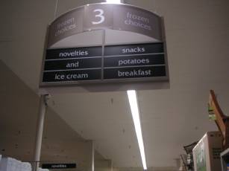
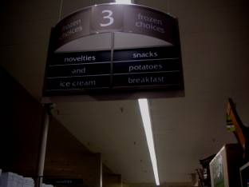
Types of invariance
Illumination

Slide 4
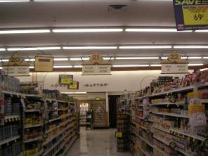
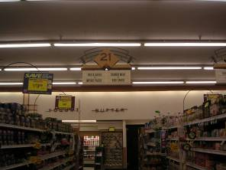
Types of invariance
Illumination
Scale

Slide 5
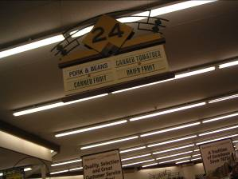
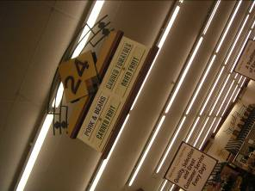
Types of invariance
Illumination
Scale
Rotation

Slide 6


Types of invariance
Illumination
Scale
Rotation
Affine

Slide 7
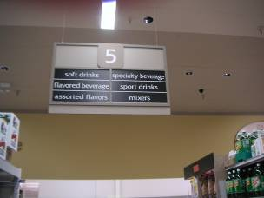
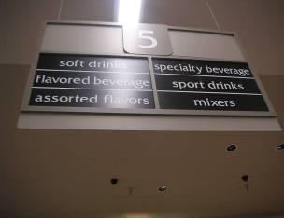
Types of invariance
Illumination
Scale
Rotation
Affine
Full Perspective

Slide 8
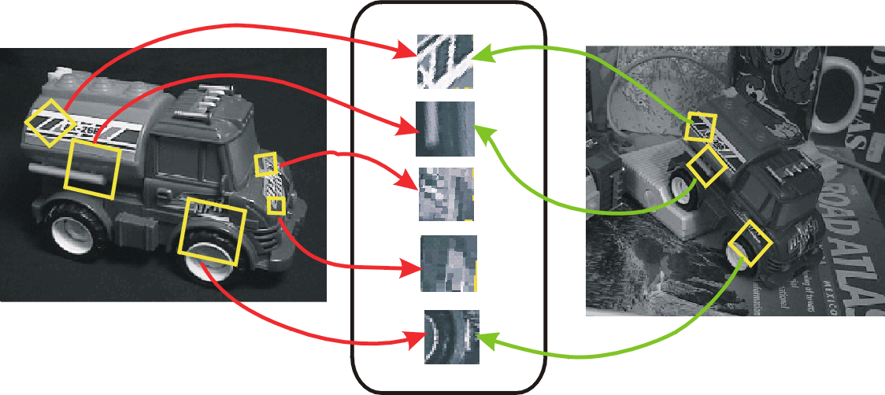
Idea of SIFT
Image content is transformed into local feature coordinates that are invariant to translation, rotation, scale, and other imaging parameters
SIFT Features

Slide 9
Advantages of SIFT
Locality: features are local, so robust to occlusion and clutter
Distinctiveness: individual features can be matched to a large database of objects
Quantity: many features can be generated for even small objects
Efficiency: close to real-time performance

Slide 10
SIFT Computation – Steps
(1) Scale-space extrema detection
Extract scale and rotation invariant interest points (i.e.,keypoints).
(2) Keypoint localization
Determine location and scale for each interest point.
Eliminate “weak” keypoints
(3) Orientation assignment
Assign one or more orientations to each keypoint.
(4) Keypoint descriptor
Use local image gradients at the selected scale.

Slide 11
Scale Space
What should be sigma value for Canny and LG edge detection?
If use multiple sigma values (scales), how do you combine multiple edge maps?
Marr-Hildreth:
Spatial Coincidence assumption:
Zerocrossings that coincide over several scales are physically significant.

Slide 12
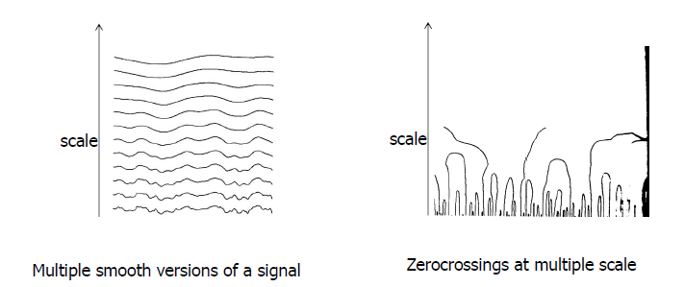
Scale Space
Apply whole spectrum of scales
Plot zerocrossings vs scales in a scale-space

Slide 13
Scale Space
Interpret scale space contours
Contours are arches, open at the bottom, closed at the top
Interval tree
Each interval corresponds to a node in a tree, whose
parent node represents larger interval, from which
interval emerged, and whose off springs represent
smaller intervals.
Stability of a node is a scale range over which the
interval exits.

Slide 14
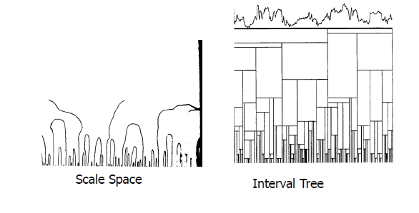
Scale Space
Top level description
Iteratively remove nodes from the tree, splicing out nodes that are less stable than any of their parents and off springs

Slide 15
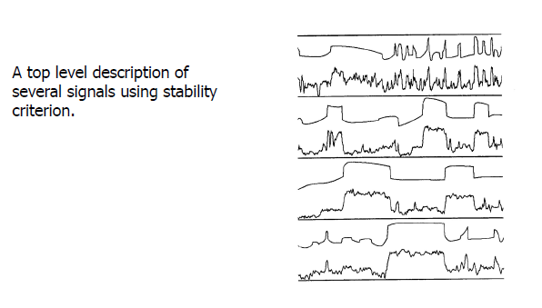
Scale Space

Slide 16
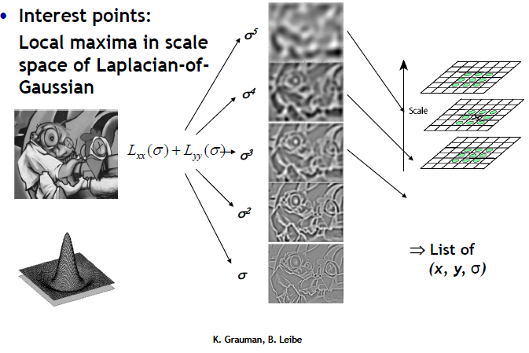
Laplacian of Gaussian (LoP)

Slide 17
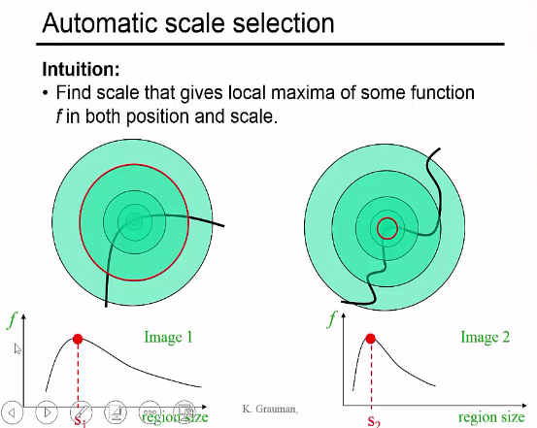

Slide 18
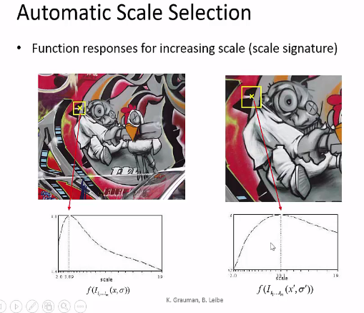

Slide 19
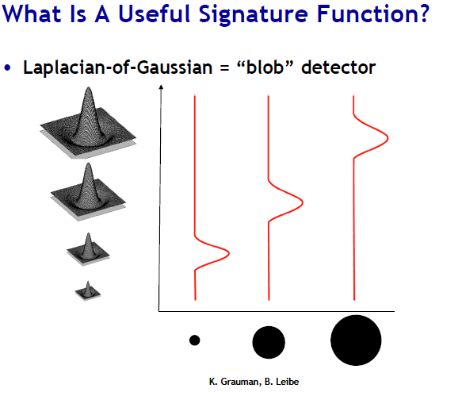

Slide 20
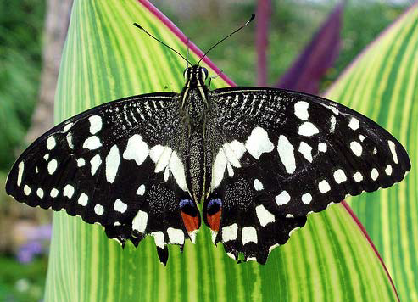
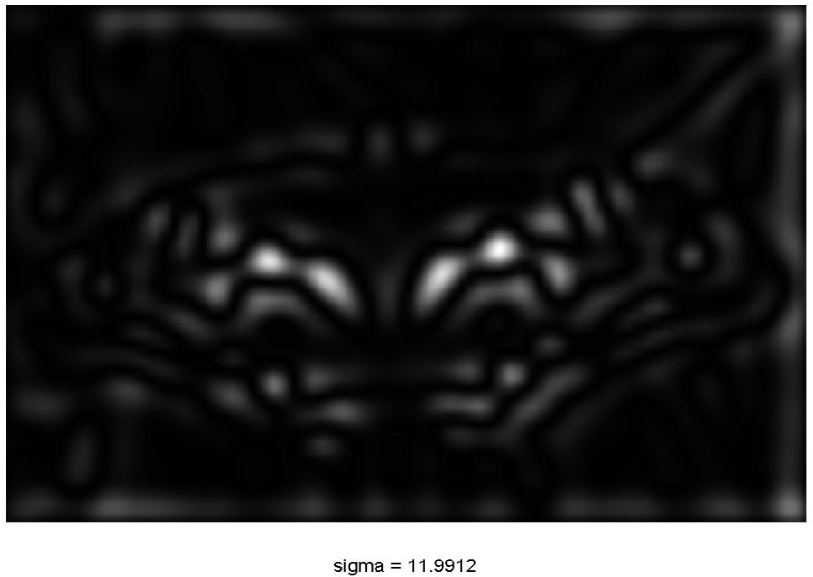
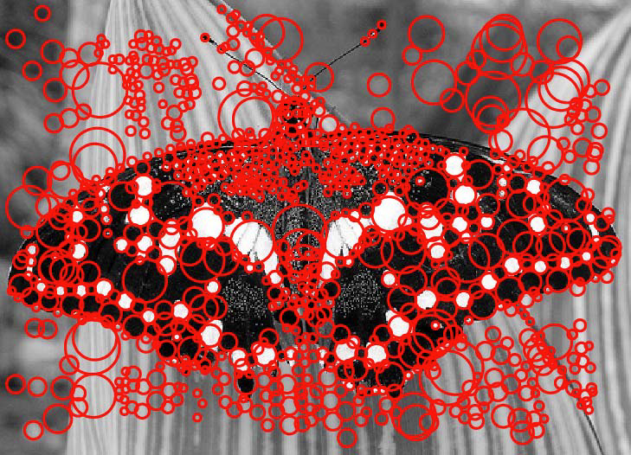
Scale Space Block Detector

Slide 21
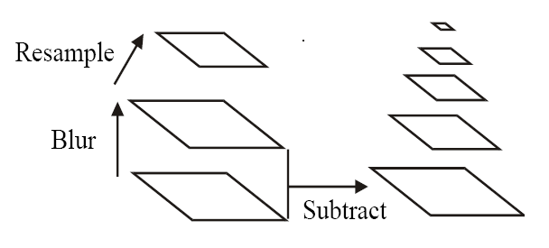
Building a Scale Space
All scales must be examined to identify scale invariant features.
An efficient function is to compute the Laplacian Pyramid (Difference of Gaussian) (Burt & Adelson, 1983)

Slide 22
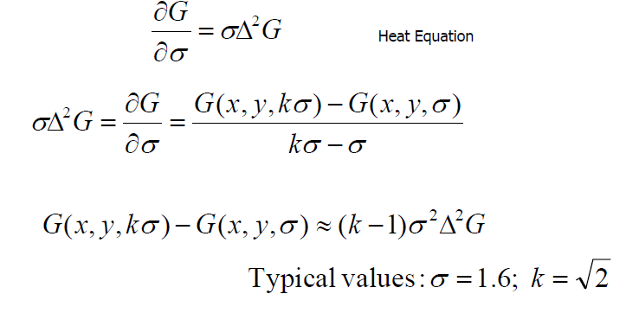
Approximation LoG by DoG

Slide 23
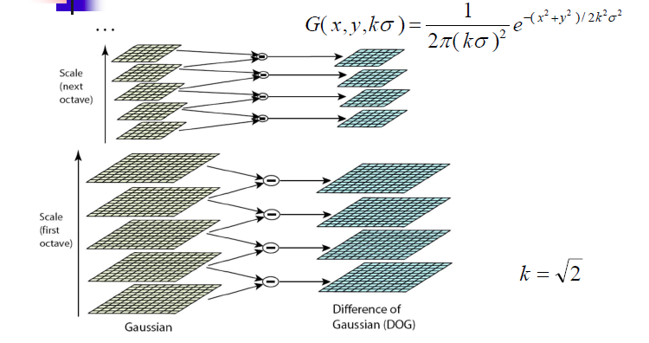
Building a Scale Space

Slide 24
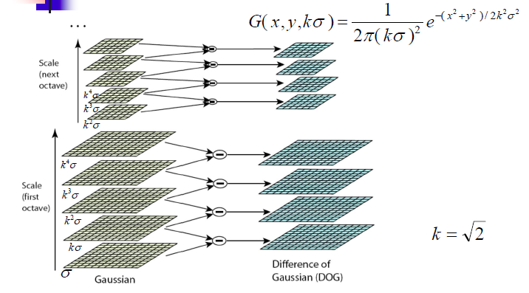
Building a Scale Space

Slide 25
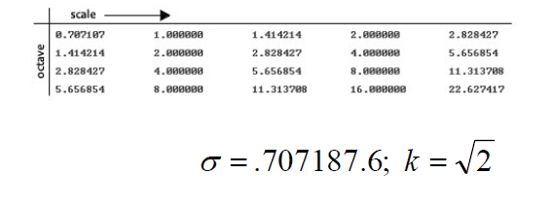
Building a Scale Space

Slide 26
How many scale per octave?
A collection of 32 real images drawn from a diverse range, including:
Outdoor scenes, human faces, aerial photographs and industrial.
Each image is then subject to a range of transformation.
Rotation, scaling, affine strech, change in brightness
contrast and addition of image noise.

Slide 27
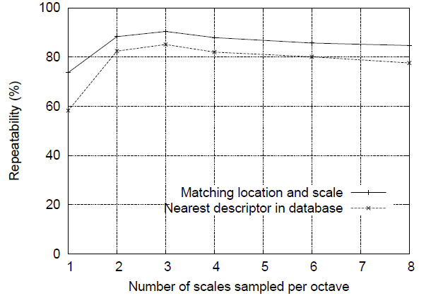
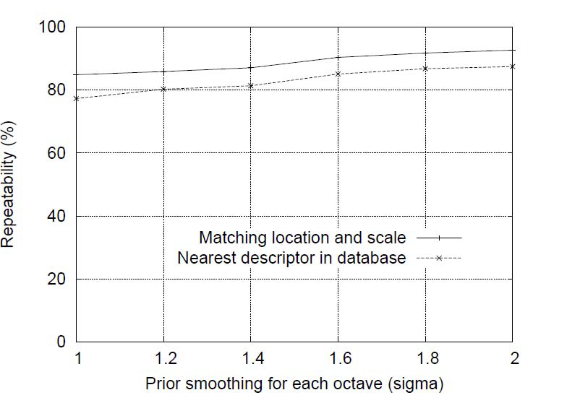
Building a Scale Space
How many octave per scale?
Initial Value of Sigma

Slide 28
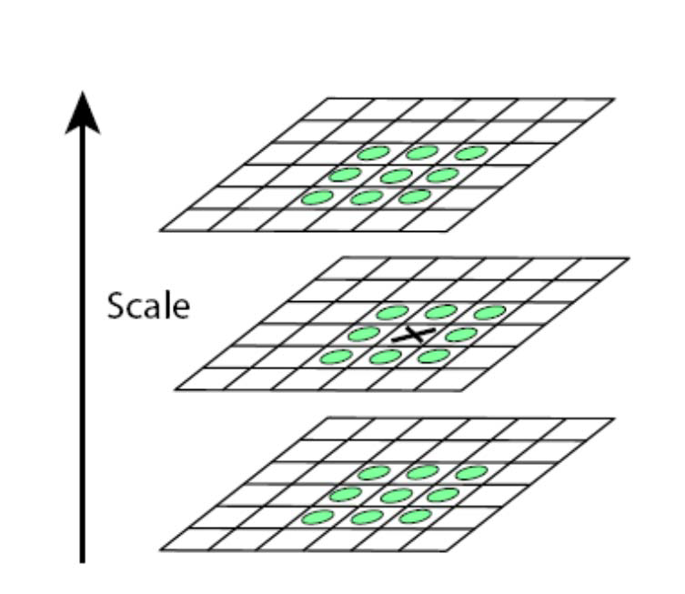
Scale Space Peak Detection
Compare a pixel (X) with 26 pixels in current and adjacent scales (Green Circles)
Select a pixel (X) if larger/smaller than all 26 pixels
Large number of extrema, computationally expensive
Detect the most stable subset with a coarse sampling of scales

Slide 29
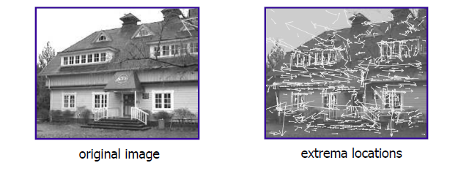
Key Point Localization
Candidates are chosen from extrema detection.

Slide 30
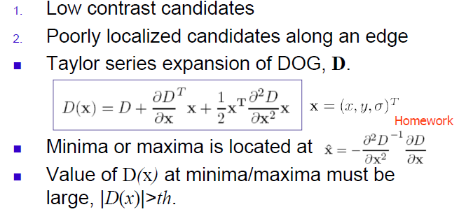
Initial Outlier Rejection

Slide 31
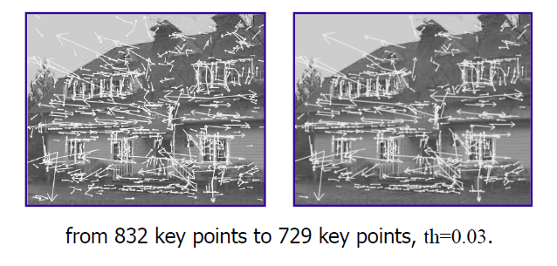
Initial Outlier Rejection

Slide 32
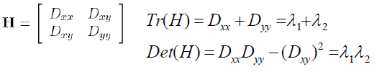
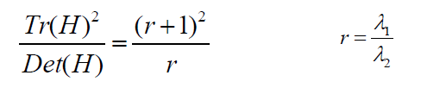
Further Outlier Rejection
DOG has strong response along edge
Assume DOG as a surface
Compute principal curvatures (PC)
Along the edge one of the PC is very
low, across the edge is high
Use Trace and Det to Harris corner detector.
Compute Hessian of D
Remove outliers by evaluating

Slide 33
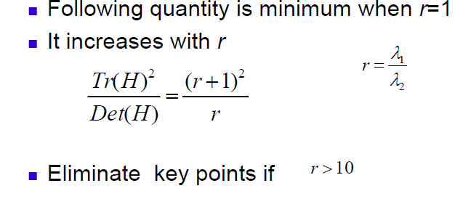
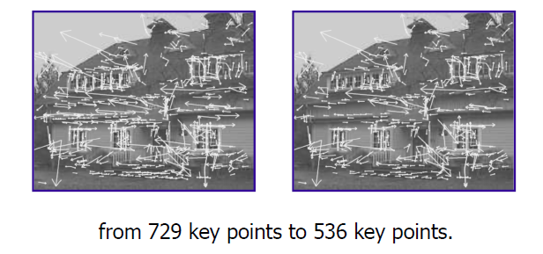
Further Outlier Rejection

Slide 34
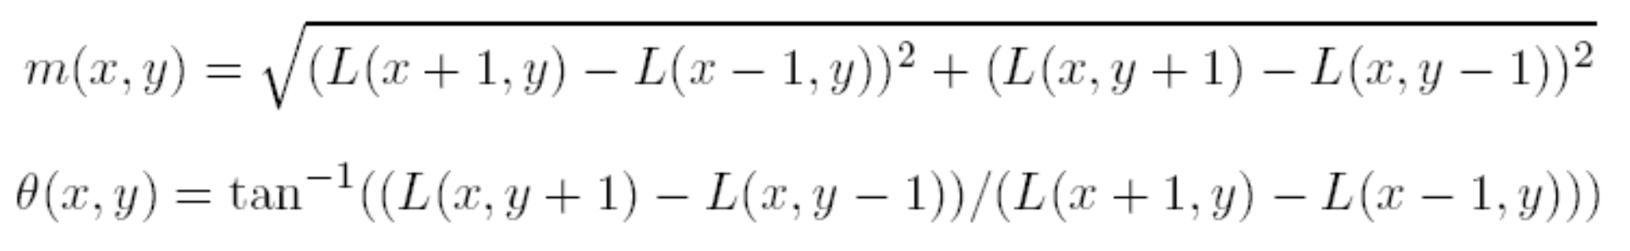
Orientation Assignment
To achieve rotation invariance
Compute central derivatives, gradient magnitude and direction of L (smooth image) at the scale of key point (x,y).

Slide 35
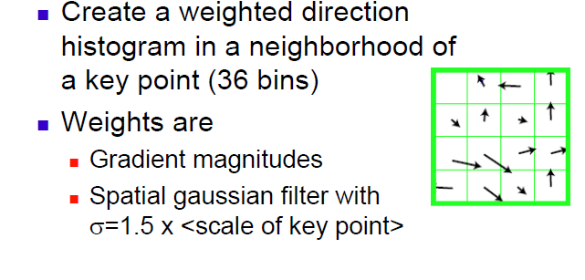
Orientation Assignment

Slide 36
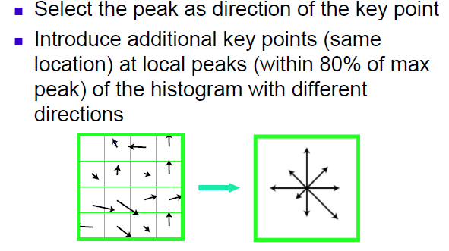
Orientation Assignment

Slide 37
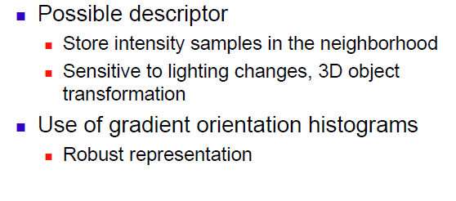
Local Image Descriptor as Key Point

Slide 38
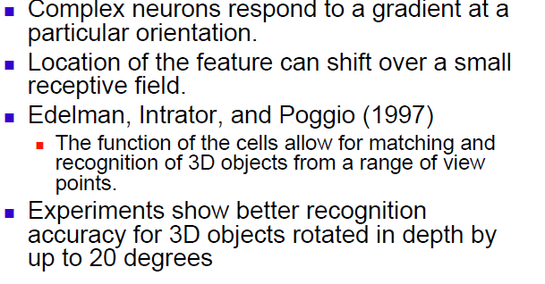
Similarity to IT cortex

Slide 39
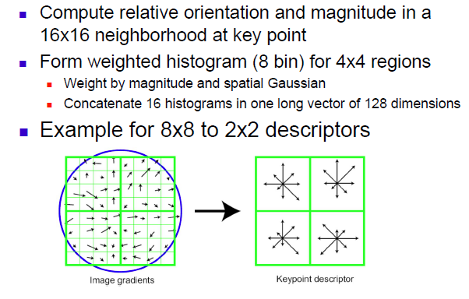
Extraction of Local Image Descriptors at Key Points

Slide 40
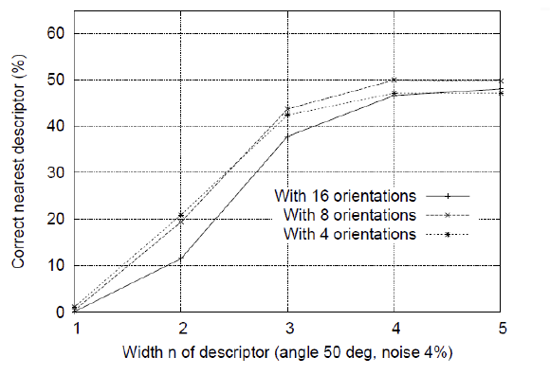
Descriptor Regions (n by n)

Slide 41
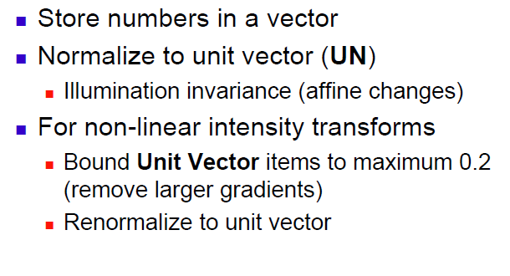
Extraction of Local Image Descriptors at Key Points

Slide 42
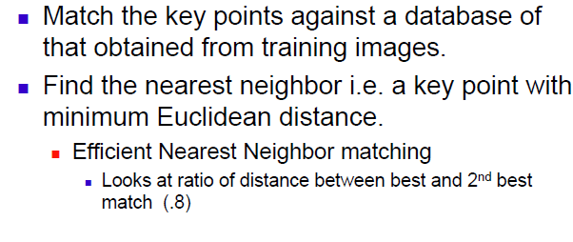
Key point matching

Slide 43
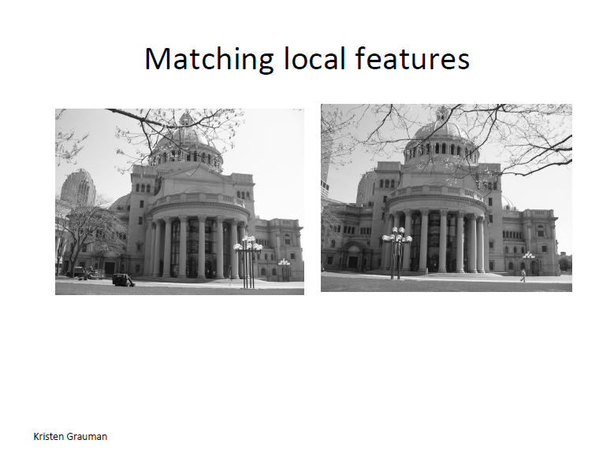

Slide 44
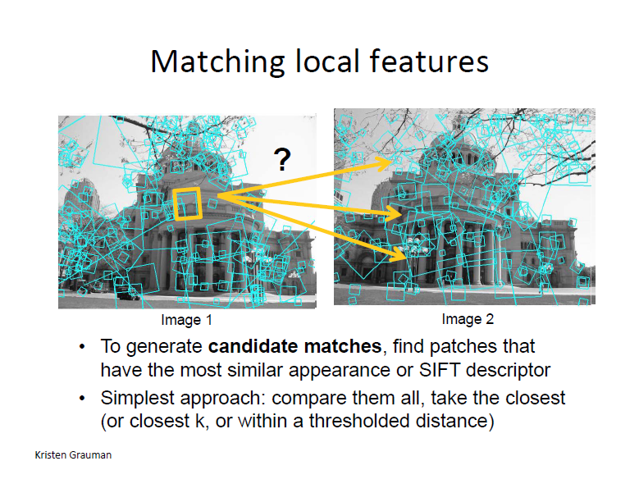

Slide 45
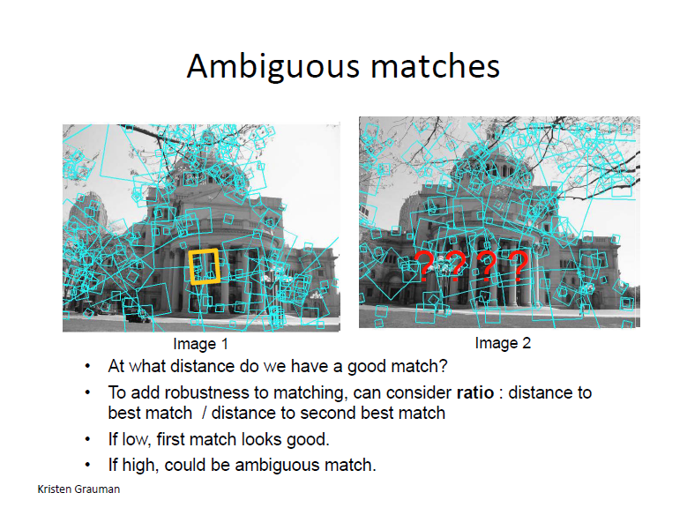

Slide 46
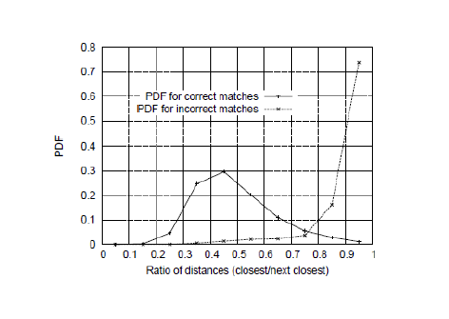
The ratio of distance from the closest to the distance of the second closest

Slide 47
Reference
D. Lowe. Distinctive image features from scale invariant key points., International Journal of Computer Vision 2004.

